Slide 1
THE ADDICTIONS WORKFORCE IN MASSACHUSETTS
Current and Upcoming Initiatives
May 12, 2022
Jen Parks, MSW
BSAS Assistant Director for Provider Support

Slide 2
Providing Information and Supporting Communication
Job & Resume Postings
Career/position options and information
Peer Recovery Coach info and Training pages
General Training and Events calendar
Resources for working with specific populations
www.careersofsubstance.org
Peer Recovery Coach Hub
https://massrchub.org
A place for Recovery Coaches and Recovery Coach Supervisors to learn, engage, and grow

Slide 3
Supporting Workforce Education
Current activities:
Black Addiction Counselor Education (BACE)
Latinx Addiction Counselor Education (LACE)
Addiction Education Advisory Group
Mass Loan Repayment Program

Slide 4
Supporting Workforce Education
Upcoming activities:
Expanded culturally responsive workforce development programming
Opportunities for paid internships
Recovery Education Collaborative (RFR)
Tuition support/scholarship program

Slide 5
Training Opportunities (sample)
Core counseling skills
Co-occurring disorders
Prevention skills
Work with priority populations
Racial equity/Cultural humility
Recovery coaching/supervising
Screening/Brief Intervention
Motivational Interviewing
Clinical Supervision
Trauma-informed care
Opioid overdose & response
Sexual/domestic violence
De-escalation
Medication management
New England School of Addiction Studies (register today!)
Coming Soon:
eLearning Management System
Free, self-paced trainings
Intro level and beyond
Required topics for licensure

Slide 6
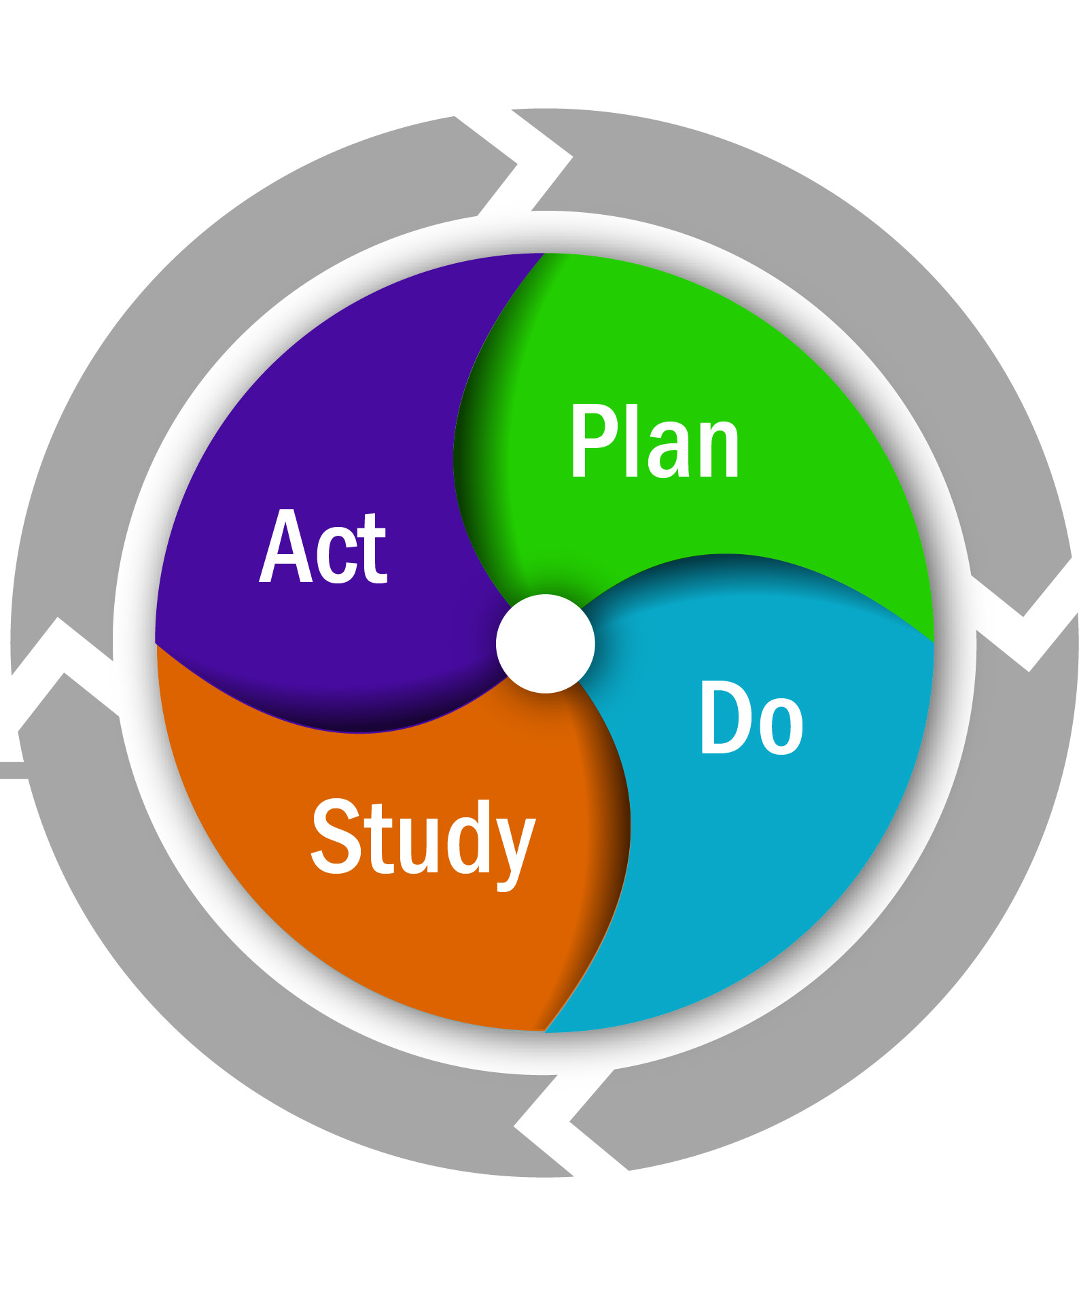
Ongoing Process and System Improvement
NIATx process improvement
EMO Health medication technical assistance
Learning Communities/COPs
Building Resilient Systems/Racial Equity Training
BIPOC retention, advancement and leadership opportunities
Co-occurring MH and SUD-Enhanced program support
Gender-specific and pregnancy-enhanced workforce development
Recovery Coach Learning Communities

Slide 7
Additional Workforce Resources
Licensure and Certification (LADC, CADC, CARC) info
Bureau of Substance Addiction Services (BSAS) Licensing: https://www.mass.gov/ladc-and-substance-use-disorder-treatment-program-licensing
Massachusetts Board of Substance Abuse Counselor Certification: www.MBSACC.com
LADC & CADC comparison chart: https://careersofsubstance.org/advance-your-career/licensure-certification/licensure-and-certification-a-comparison-of-requirements
Education info
BACE Program: https://blackcounselors.adcare-educational.org/
LACE Program: https://lbhwtp.adcare-educational.org/
Statewide training vendors
AdCare Educational Institute of New England: www.adcare-educational.org / New England School of Addiction & Prevention Studies
Institute for Health and Recovery: http://www.healthrecovery.org/trainings/
Praxis (C4 Innovations): https://c4innovates.com/training-technical-assistance/praxis/
Health Resources in Action (HRiA): https://hria.org/
Center for Strategic Prevention Support (CSPS): https://csps-ma.org/

Slide 8
Notes:
Thank you!

